Slide 1


University of Technology and Education
Faculty of Electrical & Electronic Engineering
Lecture:
IMAGE PROCESSING
Chapter 3:
Fourier Transforms
Nguyen Thanh Hai, PhD
1
Notes:
1

Slide 2
University of Technology and Education
Faculty of Electrical & Electronic Engineering
Image Transforms
Example: Find the Fourier transform of the following 4x4 image
Solution:
- One has the row, M=4 ; the column, N=4
- Transform matrix U(x,u) using the formula:
Using the formula of Euler, we have
2
Nguyen Thanh Hai, PhD
Notes:
2

Slide 3
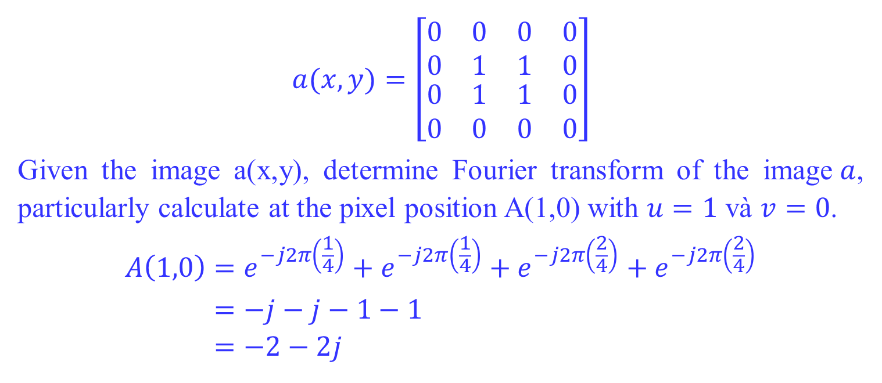
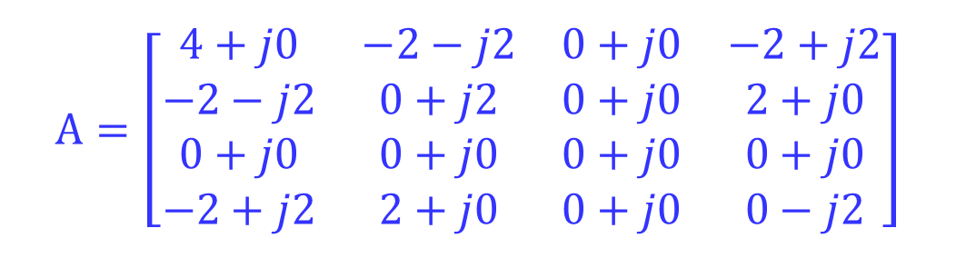
University of Technology and Education
Faculty of Electrical & Electronic Engineering
Image Transforms
$$a(x,y)=\left[\begin{matrix}\begin{matrix}0 & 0 \\ 0 & 1\end{matrix} & \begin{matrix}0 & 0 \\ 1 & 0\end{matrix} \\ \begin{matrix}0 & 1 \\ 0 & 0\end{matrix} & \begin{matrix}1 & 0 \\ 0 & 0\end{matrix}\end{matrix}\right]$$
Given the image a(x,y), determine Fourier transform of the image$a$, particularly calculate at the pixel position A(1,0) with $u=1$ và $v=0$.
$$A\left(1,0\right)=e^{−j2π\left(\frac{1}{4}\right)}+e^{−j2π\left(\frac{1}{4}\right)}+e^{−j2π\left(\frac{2}{4}\right)}+e^{−j2π\left(\frac{2}{4}\right)} \\ =−j−j−1−1 \\ =−2−2j$$
$$A=\left[\begin{matrix}4+j0 & −2−j2 & 0+j0 & −2+j2 \\ −2−j2 & 0+j2 & 0+j0 & 2+j0 \\ 0+j0 & 0+j0 & 0+j0 & 0+j0 \\ −2+j2 & 2+j0 & 0+j0 & 0−j2\end{matrix}\right]$$
3
Nguyen Thanh Hai, PhD
Notes:
3

Slide 4
University of Technology and Education
Faculty of Electrical & Electronic Engineering
Image Transforms
clear all
% define a matrix
f=[0 0 0 0; 0 1 1 0;0 1 1 0;0 0 0 0]
%f=[0 0 0 0; 0 1 1 0;0 1 1 0;0 0 0 0;0 0 0 0];
%f=[0 0 0 0; 0 255 255 0;0 255 255 0;0 0 0 0]
%f=[0 0 0 0 0; 0 1 1 1 0;0 1 1 1 0;0 0 0 0 0]
%f=[0 0 0 0 0; 0 1 1 1 0;0 1 1 1 0;0 1 1 1 0;0 0 0 0 0]
% FT
F=fft2(f)
%--Inverse FT
G=ifft2(F)
4
Nguyen Thanh Hai, PhD
Notes:
4

Slide 5
University of Technology and Education
Faculty of Electrical & Electronic Engineering
Image Transforms
f =
0 0 0 0
0 1 1 0
0 1 1 0
0 0 0 0
F =
4.0000 + 0.0000i -2.0000 - 2.0000i 0.0000 + 0.0000i -2.0000 + 2.0000i
-2.0000 - 2.0000i 0.0000 + 2.0000i 0.0000 + 0.0000i 2.0000 + 0.0000i
0.0000 + 0.0000i 0.0000 + 0.0000i 0.0000 + 0.0000i 0.0000 + 0.0000i
-2.0000 + 2.0000i 2.0000 + 0.0000i 0.0000 + 0.0000i 0.0000 - 2.0000i
G =
0 0 0 0
0 1 1 0
0 1 1 0
0 0 0 0
5
Nguyen Thanh Hai, PhD
Notes:
5

Slide 6
University of Technology and Education
Faculty of Electrical & Electronic Engineering
Image Transforms
Example: Write code to calculate the Fourier image using MATLAB
clear all;clc
a=zeros(4,4);
a(2:3,2:3)=1;
for u=1:size(a,1)
for v=1:size(a,2)
for x=1:size(a,1)
for y=1:size(a,2)
phi=(2*pi*(u-1)*(x-1)+2*pi*(v-1)*(y-1))/4;
p(x,y)=complex(cos(phi),-sin(phi));
end
end
F(u,v)=sum(sum(p.*a));
end
end
6
Nguyen Thanh Hai, PhD
Notes:
6

Slide 7
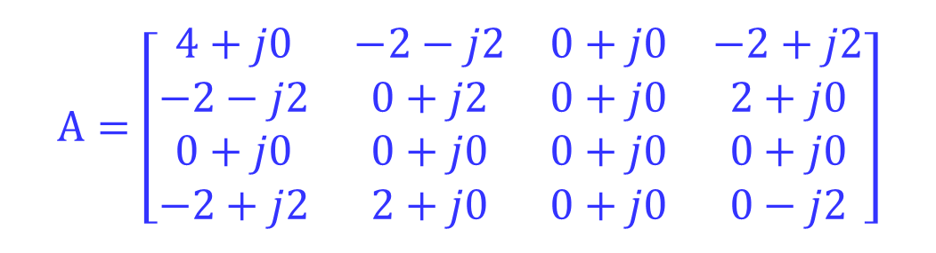
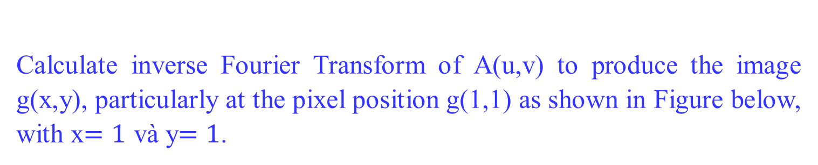
University of Technology and Education
Faculty of Electrical & Electronic Engineering
Image Transforms
Calculate inverse Fourier Transform of A(u,v) to produce the image g(x,y), particularly at the pixel position g(1,1) as shown in Figure below, with x$=1$ và y$=1$.
$$A=\left[\begin{matrix}4+j0 & −2−j2 & 0+j0 & −2+j2 \\ −2−j2 & 0+j2 & 0+j0 & 2+j0 \\ 0+j0 & 0+j0 & 0+j0 & 0+j0 \\ −2+j2 & 2+j0 & 0+j0 & 0−j2\end{matrix}\right]$$
7
Nguyen Thanh Hai, PhD
Notes:
7

Slide 8
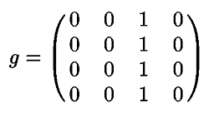
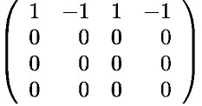
University of Technology and Education
Faculty of Electrical & Electronic Engineering
Image Transforms
Exercise
Compute the DFT, its absolute, phase, log of the FT and the power spectrum of the following image
Solution
8
Nguyen Thanh Hai, PhD
Notes:
8

Slide 9
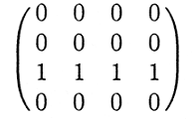
University of Technology and Education
Faculty of Electrical & Electronic Engineering
Image Transforms
Exercise
Verify the relationship of the DFTs of the following images
A
B
9
Nguyen Thanh Hai, PhD
Notes:
9

Slide 10
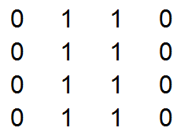
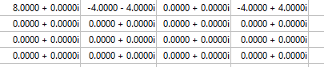
University of Technology and Education
Faculty of Electrical & Electronic Engineering
Image Transforms
Exercise
Compute the DFT, its absolute, phase, log of the FT and the power spectrum of the following image
Solution
10
Notes:
10

Slide 11
University of Technology and Education
Faculty of Electrical & Electronic Engineering
Image Transforms
Exercise
Compute the DFT, its absolute, phase, log of the FT and the power spectrum of the following image
11
Notes:
11

Slide 12
University of Technology and Education
Faculty of Electrical & Electronic Engineering
Image Transforms
Exercise
Compute the DFT, its absolute, phase, log of the FT and the power spectrum of the following image
12
Notes:
12

Slide 13
University of Technology and Education
Faculty of Electrical & Electronic Engineering
Image Transforms
Creat the function fft2_new.m to calculate Fourier transform of an image
function G=fft2_new(g)
% G is fourier tranform of g
%===================
% Get size of matrix f
M=size(g,1); % get number of rows
N=size(g,2) ; % get number of columns
%===================
%create matrix U
%U(x,u)=exp(-j*2*pi*x*u/M)
% x, u run from 0 to M-1
U=[ ];
for x=0:M-1
for u=0:M-1
U(x+1,u+1)=exp(-j*2*pi*m*p/M);
end
end
13
Nguyen Thanh Hai, PhD
Notes:
13

Slide 14
University of Technology and Education
Faculty of Electrical & Electronic Engineering
Image Transforms
Creat the function fft2_new.m to calculate Fourier transform of an image
%===================
% create matrix V
%V(y,v)=exp(-j*2*pi*y*v/N)
% y, v run from 0 to N-1
V=[ ];
for y=0:N-1
for v=0:N-1
V(y+1,v+1)=exp(-j*2*pi*y*v/N);
end
end
%===================
%Fourier transform
G=U*g*V;
14
Nguyen Thanh Hai, PhD
Notes:
14

Slide 15
University of Technology and Education
Faculty of Electrical & Electronic Engineering
Image Transforms
Creat the inverse function ifft2_new.m to calculate inverse Fourier transform of an image
function g=ifft2_new(G)
% g is invert fourier tranform of G
%===================
%Get size of matrix G
M=size(G,1); % get number of rows
N=size(G,2) ; % get number of columns
%===================
%===================
%create matrix U
%U(m,p)=exp(-j*2*pi*x*u/M)
% x, u run from 0 to M-1
U=[ ];
for x=0:M-1
for u=0:M-1
U(x+1,u+1)=exp(-j*2*pi*x*u/M);
end
end
15
Nguyen Thanh Hai, PhD
Notes:
15

Slide 16
University of Technology and Education
Faculty of Electrical & Electronic Engineering
Image Transforms
Test and compare two results on Matlab fft2 and ifft2
% Test and compare together G1 and G2, g1 và g2
g=[0 0 0 0; 0 1 1 0; 0 1 1 0; 0 0 0 0]
G1=fft2(g)
G2=fft2_new(g)
g1=ifft2(G1)
g2=ifft2_new(G1)
MAGNITUDE(G) = SQRT( REAL(G)^2+IMAGINARY(G)^2 )
PHASE(F) = ATAN( IMAGINARY(G)/REAL(G) )
16
Nguyen Thanh Hai, PhD
Notes:
16

Slide 17
University of Technology and Education
Faculty of Electrical & Electronic Engineering
Image Transforms
The End
Nguyen Thanh Hai, PhD

